Slide 1
Sensors Challenge Overview
Joe Davies, PhD
Quantinuum, LLC.

Slide 2
Introduction
Sensors challenge history
2nd sensors challenge
Proposed by Prof. Victorino Franco (Univ. of Sevilla)
First challenge
Joint MMM meeting, January 2022, New Orleans
Six participants
Goals
Give more practical/applied experience in sensors
Use sensors + teamwork + creativity to utilize sensors
Network and have fun in the process!

Slide 3
Sensor Technologies
Technology | Detectivity (pT/√Hz @1Hz) | Optimal Speed | Volume (cm³) | Power | Cost | CMOS Integrable
TMR | 10 | Hz – kHz | 1e-5 | uW | <$ 1 | Yes
GMR | 100 | Hz – MHz | 1e-5 | mW | <$ 1 | Yes
AMR | 100 | Hz – MHz | 1e-4 | mW | <$ 1 | Yes
Hall | 30,000 | Hz – kHz | 1e-4 | mW | $ 0.1 | Kind-of
Fluxgate | 1 | Hz | 1 | W | 0.1 k$ | No
Vapor | 0.01 | Hz | 1 | W | 1 k$ | No
Squid | 0.001 | Hz | 0.5 | W | >1 k$ | No
Rough order of magnitude estimates
TMR/GMR Market driven by best performance for small size, low power and cost

Slide 4
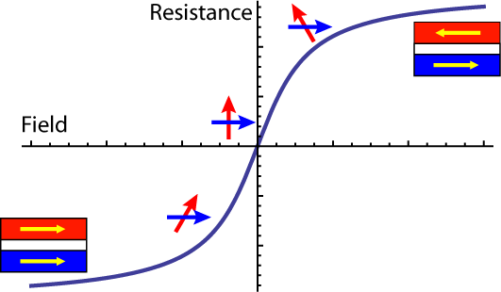
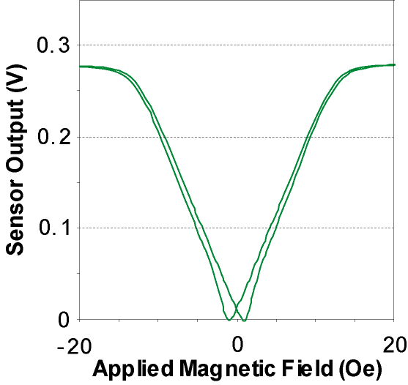
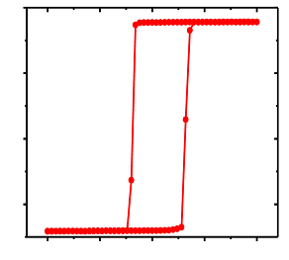
Device configurations
Magnetic property tailoring enables different device types
Digital
Bipolar
Unipolar
Resistance
Field
Cross-axis anisotropy
Magnetometry
Current sensing
Navigation
Multilayer stack
Proximity sensing
Unipolar switches
Strong uniaxial anisotropy
Memory/Switches

Slide 5
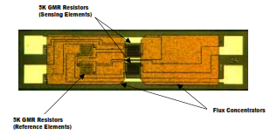
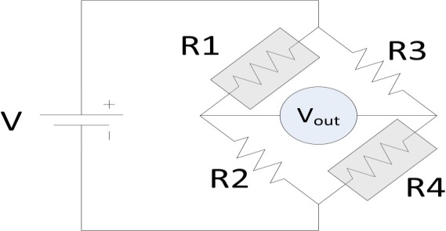
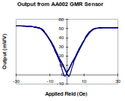
Typical Sensor, CIP GMR
Wheatstone bridge
Excellent temperature stability
Two “reference” legs
Shields or “dead” GMR
Flux concentrate “active” legs
Example: linear response, 10% GMR, Saturate at 10 Oe
→ 8.2 mV/V-Oe sensitivity

Slide 6
Field and Frequency Marketspace
Industrial controls/positioning
Hall Sensors
Magnetic Anomalies
HDD/data storage
Increasing Cost
Geophysical
GMR
AMR
TMR
Magneto-cardiography/ Encephalography
Flux Gate
Atomic/Vapor Magnetometer, SQUIDs
Adapted from “Magnetic Sensors and Magnetometers”, P. Ripka, Artech, (2001)
STT, STO, STMD

Slide 7
Sensor Marketspace
Mechanical position sensing
Cylinder positioning, flow meters, geartooth sensors, encoders
Magnetic field anomaly detection
Medical devices/biosensors
Defect/particle detections
Electric current sensing
Electric vehicles, precision motor/power control

Slide 8
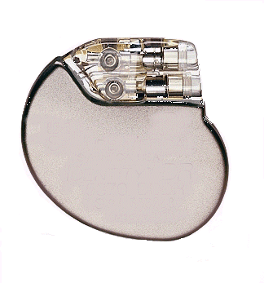
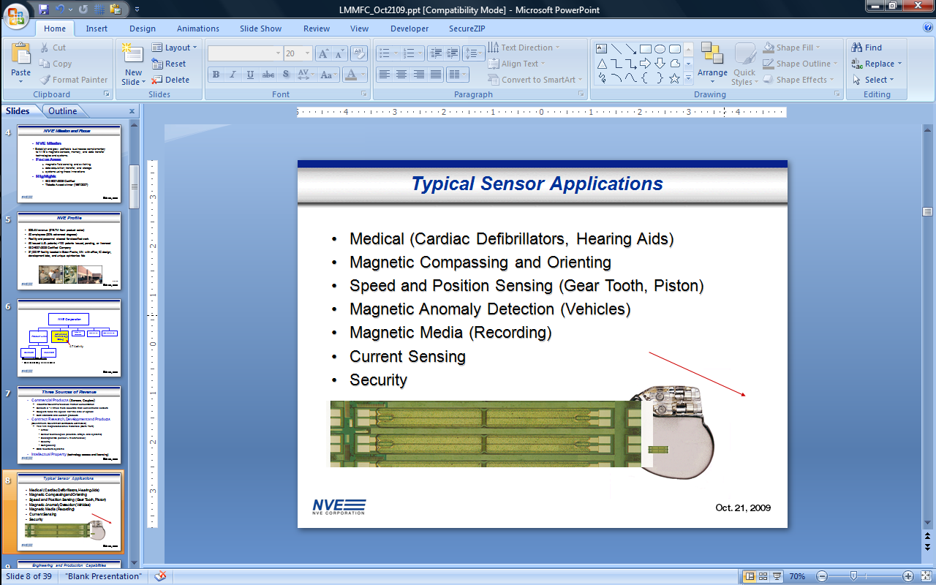
Applications
Medical device sensors (e.g., pacemakers and hearing aids)
Biomagnetics/particle detection
Anomaly detection (e.g., vehicles)
Compassing
Speed, position, and angle sensors
Data storage
Current sensors
Security
Implantable
Cardiac Defibrillator

Slide 9
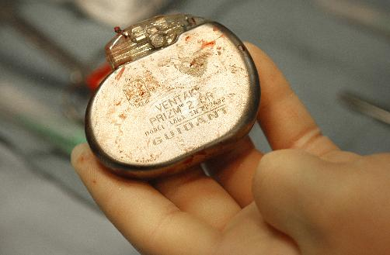
Interesting Case study: Implant Reliability
Photo: “A recalled Guidant defibrillator,” StarTribune, 8/7/05
Guidant (Boston Scientific) pacemaker recalled due to mechanical reed switch “stickage”
Magnetoresistive switches save the day

Slide 10
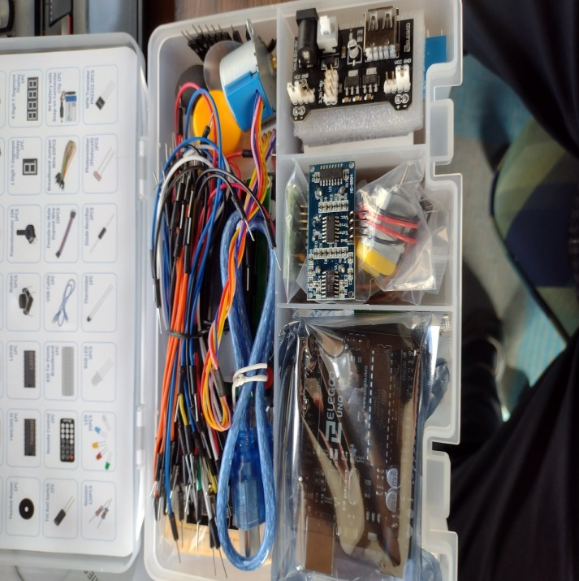
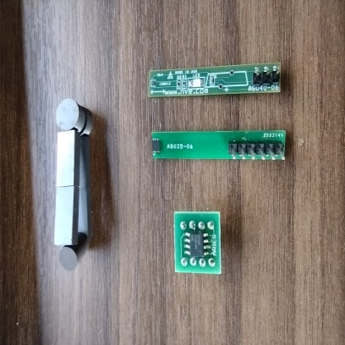

The Challenge
Find an interesting way to utilize sensors
Present solution as a Tiktok video
#mmmsensorschallenge2022

Slide 11
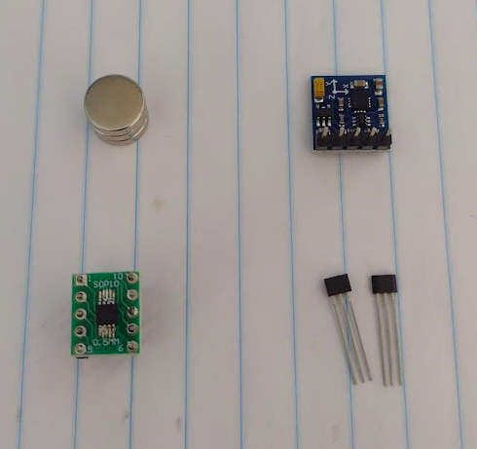
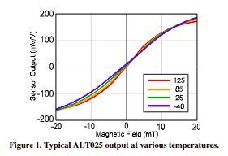

Sensors
3-axis AMR compass sensor
Magnets
Unipolar GMR Sensor
Hall Digital Switch

Slide 12

Arduino Kit
Lots of extras for the project
Need Arduino IDE for programming
“ReadAnalogVoltage” example is good starting point

Slide 13
Tiktok Submission
Submit Tiktok videos by 8pm-ish Thursday
Use #2022mmmsensorchallenge for people to find
Panel of chairs will view and judge a winner
All will be recognized in upcoming IEEE magnetics society news letter and awards/plenary session
Sensors and kits are for the teams to keep

Slide 14
Resources
Room is available each evening for meeting
Not required to use
Arduino:
https://www.arduino.cc/en/Guide
Sensor use:
NVE GMR sensor
https://www.nve.com/analogSensors
Hall Effect Sensor: Gikfun A3144/OH3144/44E/AH3144E
https://youtu.be/4-MB1jBocW4
AMR compass (I²C communication)
https://electropeak.com/learn/interfacing-gy-271-hmc5883l-compass-magnetometr-with-arduino/

